Slide 1
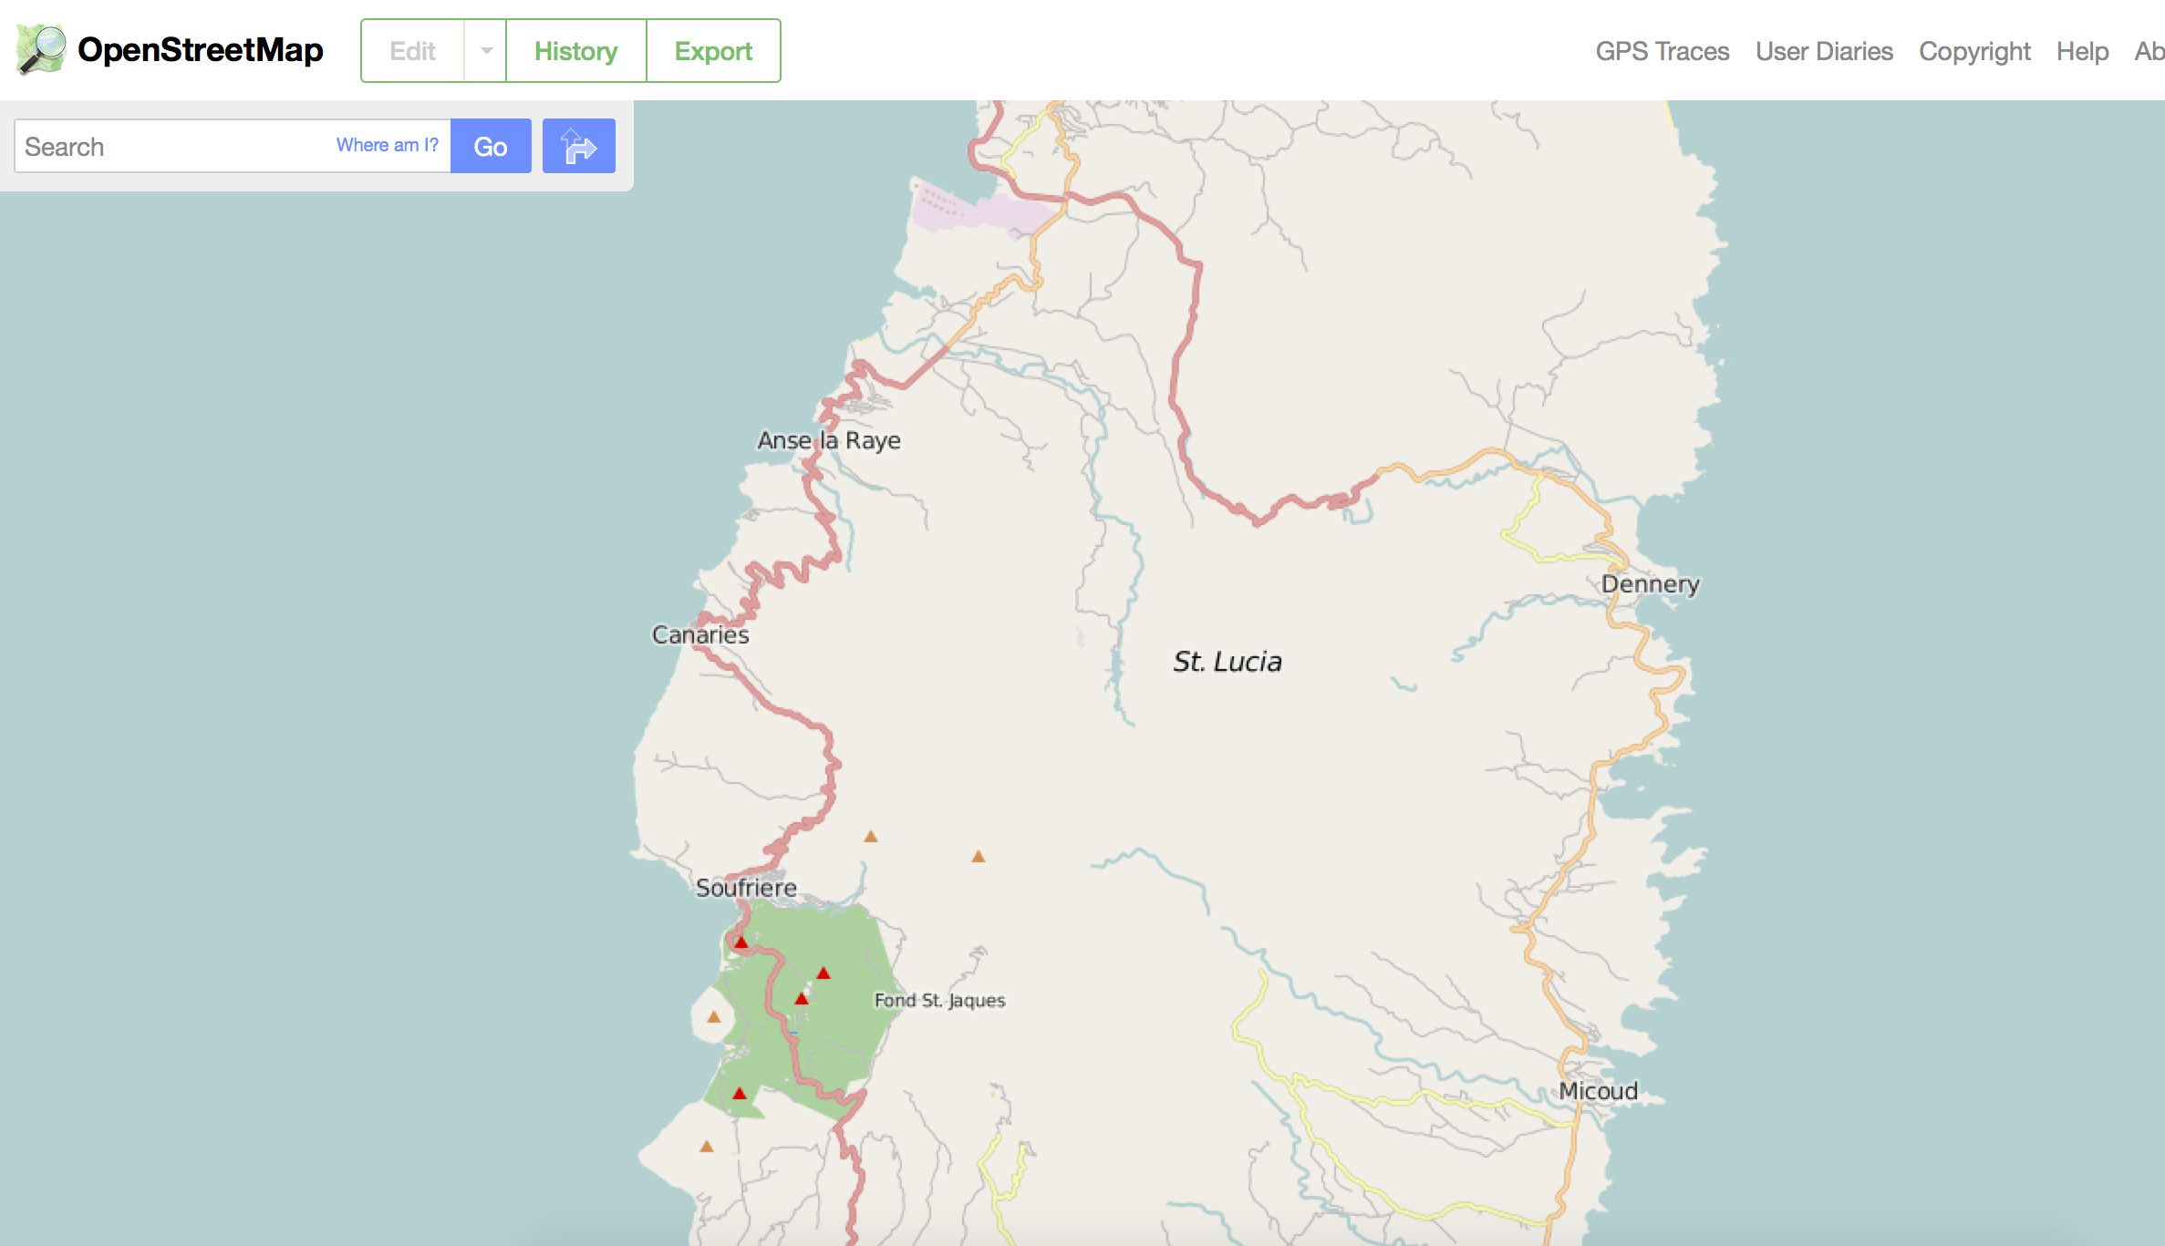
Open Map Data for Development
OpenStreetMap for Economic Development

Slide 2
About
What is OpenStreetMap?
What is TeachOSM?
Why Create Open Map Data?
Resources for Organizers
Summary

Slide 3
What is OSM?
OSM = OpenStreetMap
OpenStreetMap is a crowd-sourced map of the world with an open content license so anyone edit the map and use the data.
OpenStreetMap is often described as “Wikipedia for maps” as anyone can edit the map.

Slide 4
How does OpenStreetMap work?
Sign up for an account. Free!
Point your browser to OpenStreetMap.org
Search for your elementary/middle/high school
Not there? Digitize it!
Tag it with address, website, Wikipedia entry, Facebook page, Twitter account, etc.
Save and admire your work!

Slide 5
Restrictions? There are some…
Don’t use proprietary source data
Violates terms of copyright
No copying from Google!
OpenStreetMap is a ‘live’ database
No fantasy mapping!
Enter real, factual data

Slide 6
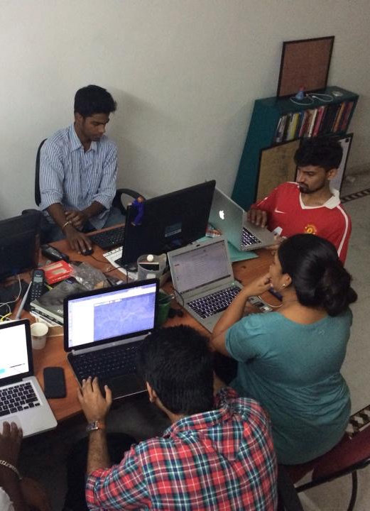
It’s more than a map
It’s an open ecosystem of
Data
Infrastructure
Governance
Communities of Interest
Services
Event driven
Mobilization, mapathons and community events, street surveys
HOT Activations, humanitarian response
MissingMaps and MapGive requests
Photo: Students in India digitizing for Nepal earthquake recovery.
Credit: Gopinath Parayil

Slide 7
Evolving ecosystem of tools
Editors: iD, JOSM
Renderings: Mapnik, CSS, Mapquest, OpenCycleMap
Data Collection: Field Papers
Streetview: Mapillary photo app
Scheduling: Tasking Manager
Data quality: Overpass Turbo, MapRoulette
Export: XAPI, MapTiles

Slide 8
Milestones in OpenStreetMap History
2004 - OpenStreetMap.org registered by Steve Coast
2005 – Map Limehouse, 1st OpenStreetMap mapping party
2005 – 1000 registered OpenStreetMap users
2006 – OpenStreetMap Foundation established
2007 – 5 million ways in OSM database
2007 – 10,000 registered OpenStreetMap users
2008 - TIGER data import for the US completed
2009 - 100,000 registered OpenStreetMap users
2010 - 200,000 registered OpenStreetMap users
2013 - 1,000,000 registered OpenStreetMap users
2015 - 2,000,000 registered OpenStreetMap users
2011 URISA/NENA Addressing Conference
7 October 2012

Slide 9
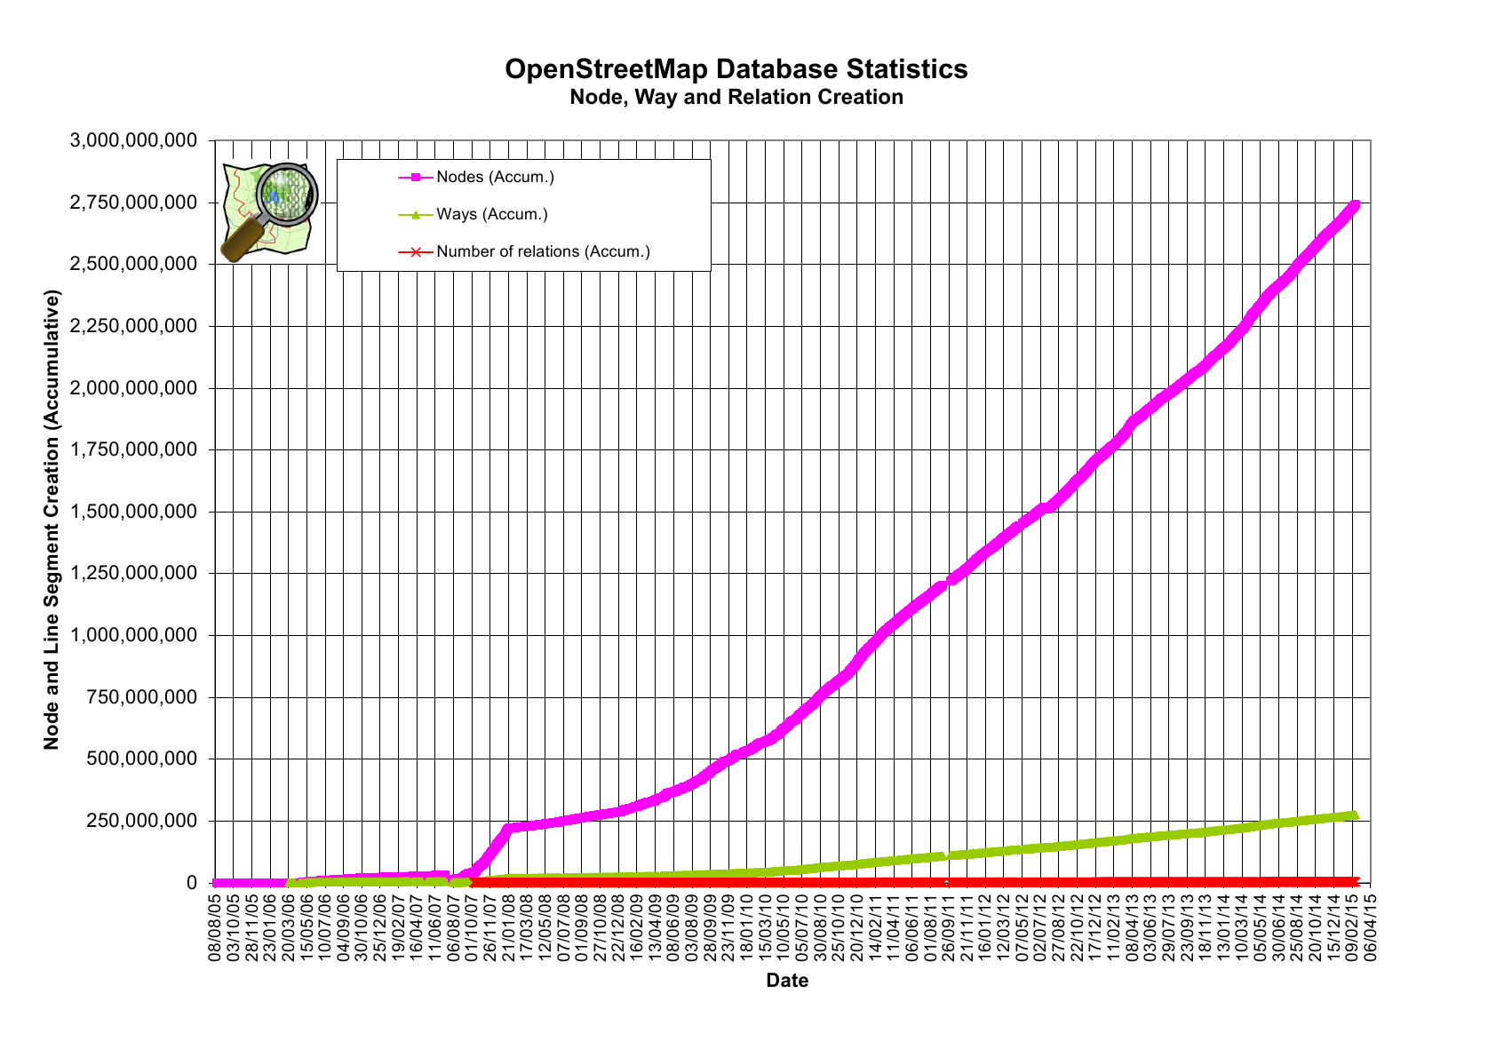

Slide 10
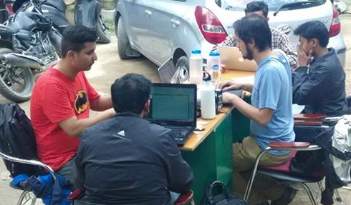
Highlight: OpenStreetMap and Nepal Earthquake
OpenStreetMappers in Nepal one day after quake.
Credit: PierZen

Slide 11
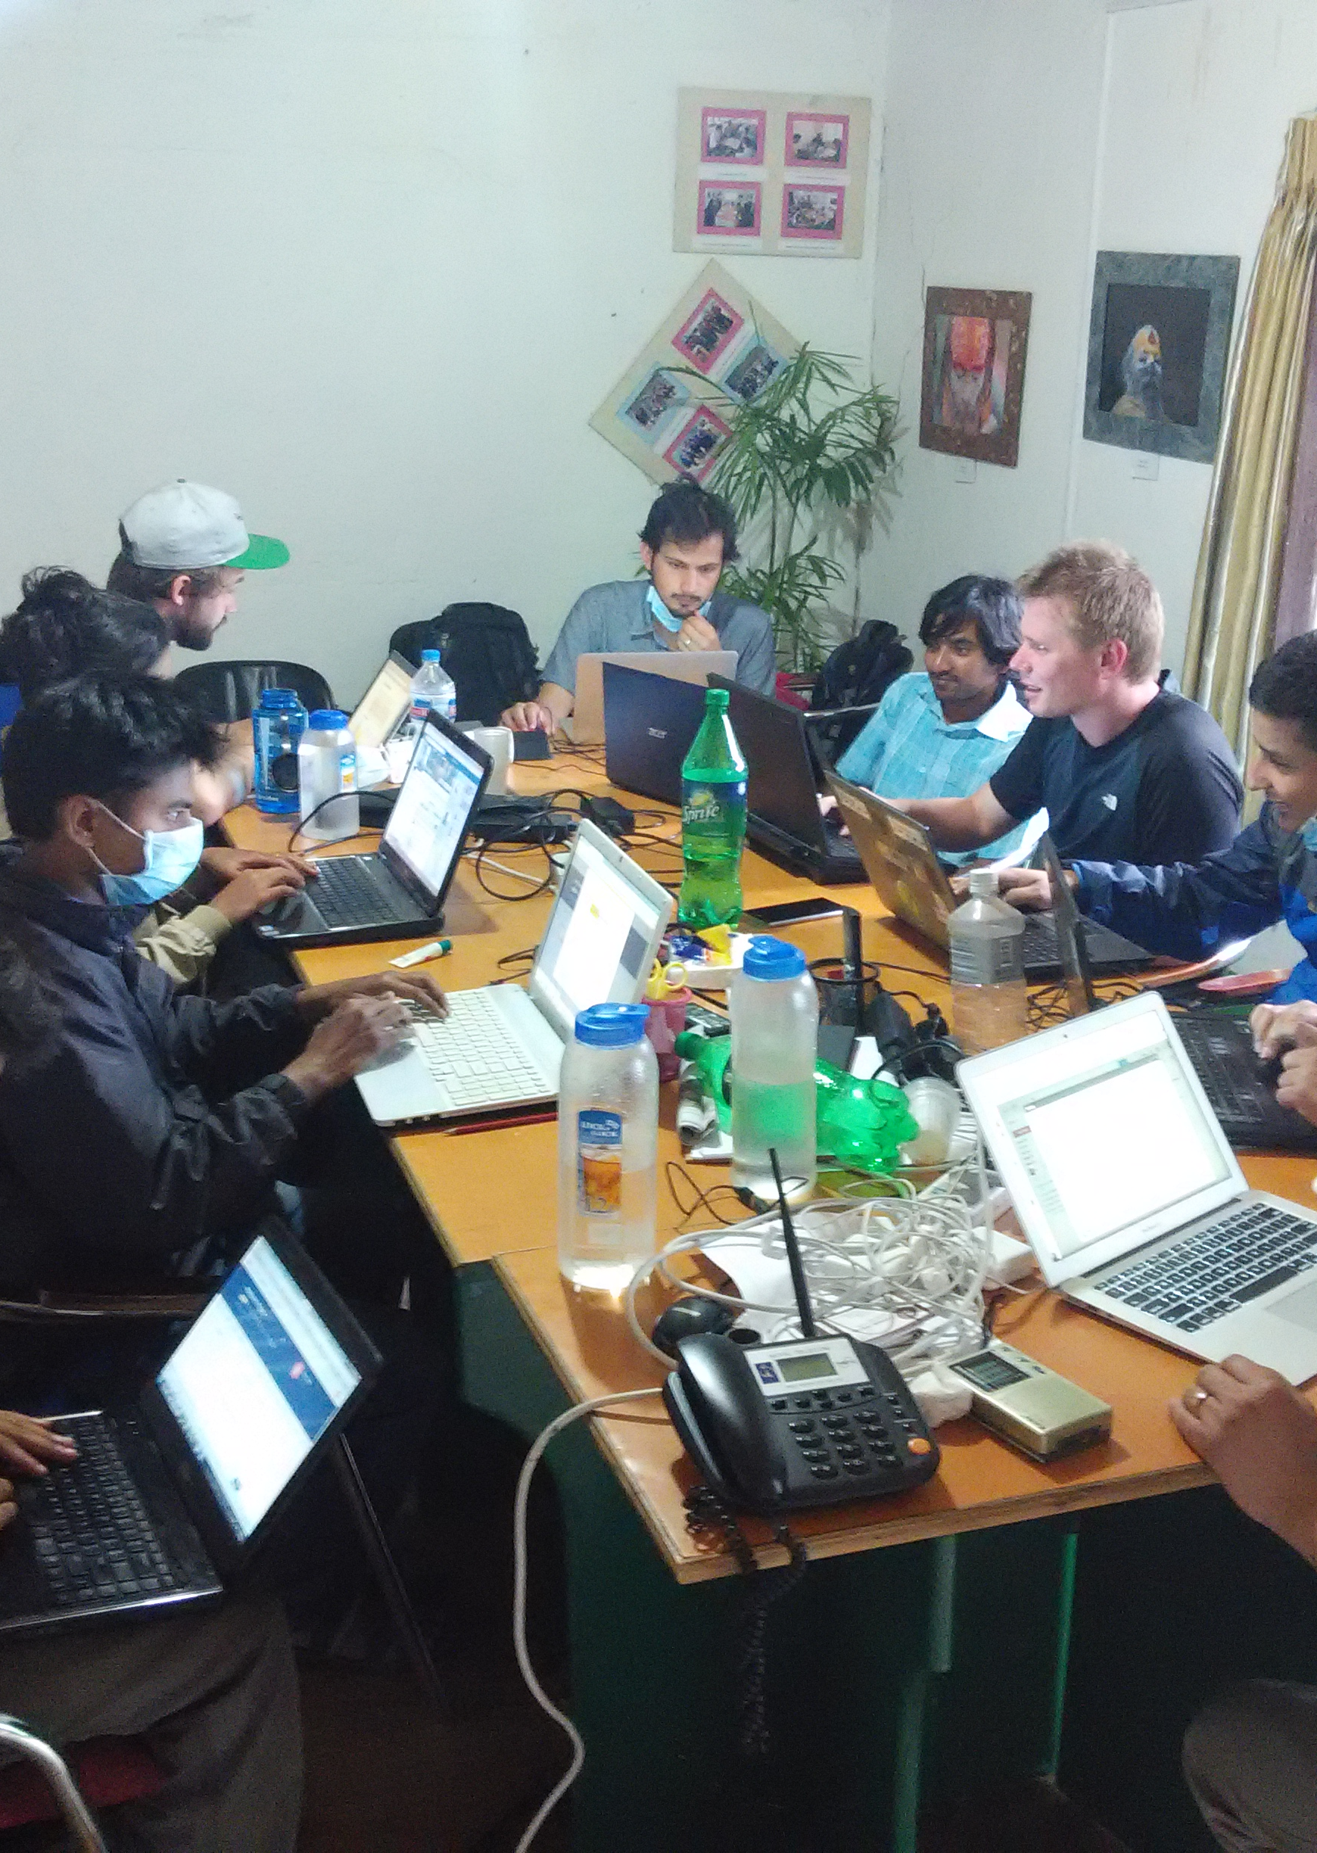
OpenStreetMap Plays Key Role in Disaster Relief
Mobilization began on 25 April within hours of quake
~2300 mappers actively mapping around the world
71786 edits to highways, 143372 edits to buildings, 33806 changesets since April 25, 2015.
Maps used by rescue & recovery specialists, NGOs, government agencies
Photo: OpenStreetMappers at Kathmandu Living Labs one day after the quake.
Credit: KLL

Slide 12
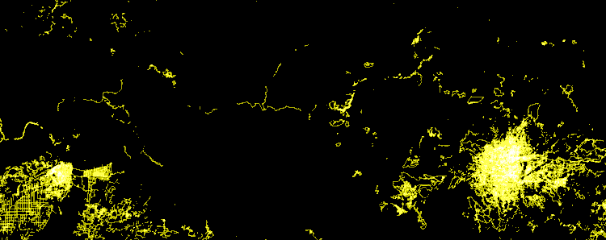
Post-quake edits to OpenStreetMap in Nepal
Credit: Eric Fischer
https://www.mapbox.com/blog/nepal-earthquake-animation/

Slide 13
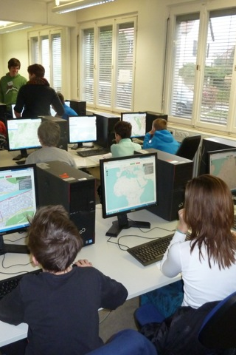
TeachOSM: A Resource for Open Map Data
Infrastructure for Organizers
Photo: middle-school school students learning to map.
Credit: MaptimeLex/Lyzi Diamond

Slide 14
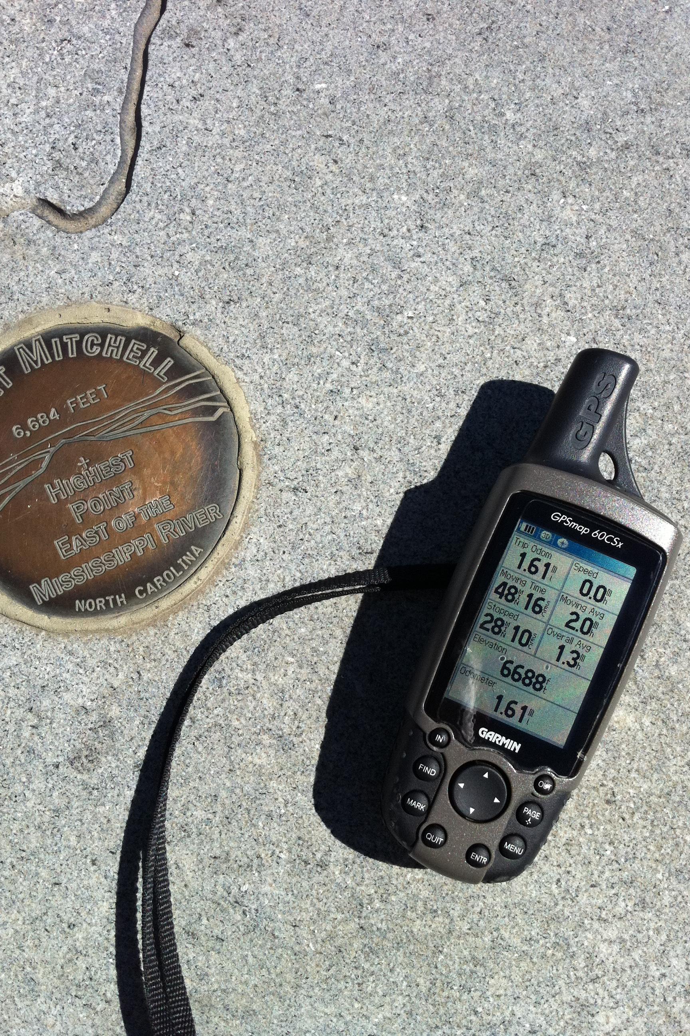
What is TeachOSM?
TeachOSM is a growing resource for trainers & educators at all levels to introduce open source mapping in their classes & trainings.
TeachOSM offers modular lessons in applied mapping using OpenStreetMap.
TeachOSM has resources to help instructors to identify, assign, manage and assess a mapping data quality.
Photo: Mapping peaks using GPS.
Credit: SEJohnson

Slide 15
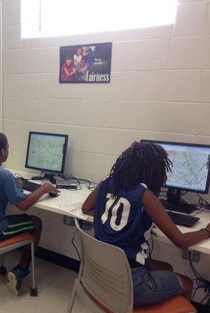
For Technicians…
Acquire basic digital mapping skills
iD map editor
TeachOSM Tasking Manager
Expand opportunity for vocational learning
Service opportunities in mapping:
Humanitarian OpenStreetMap Team (HOT)
MapGive
MissingMaps
Cultivate geo-literacy through guided mapping projects
Photo: middle-school school students learning to map.
Credit: SEJohnson

Slide 16
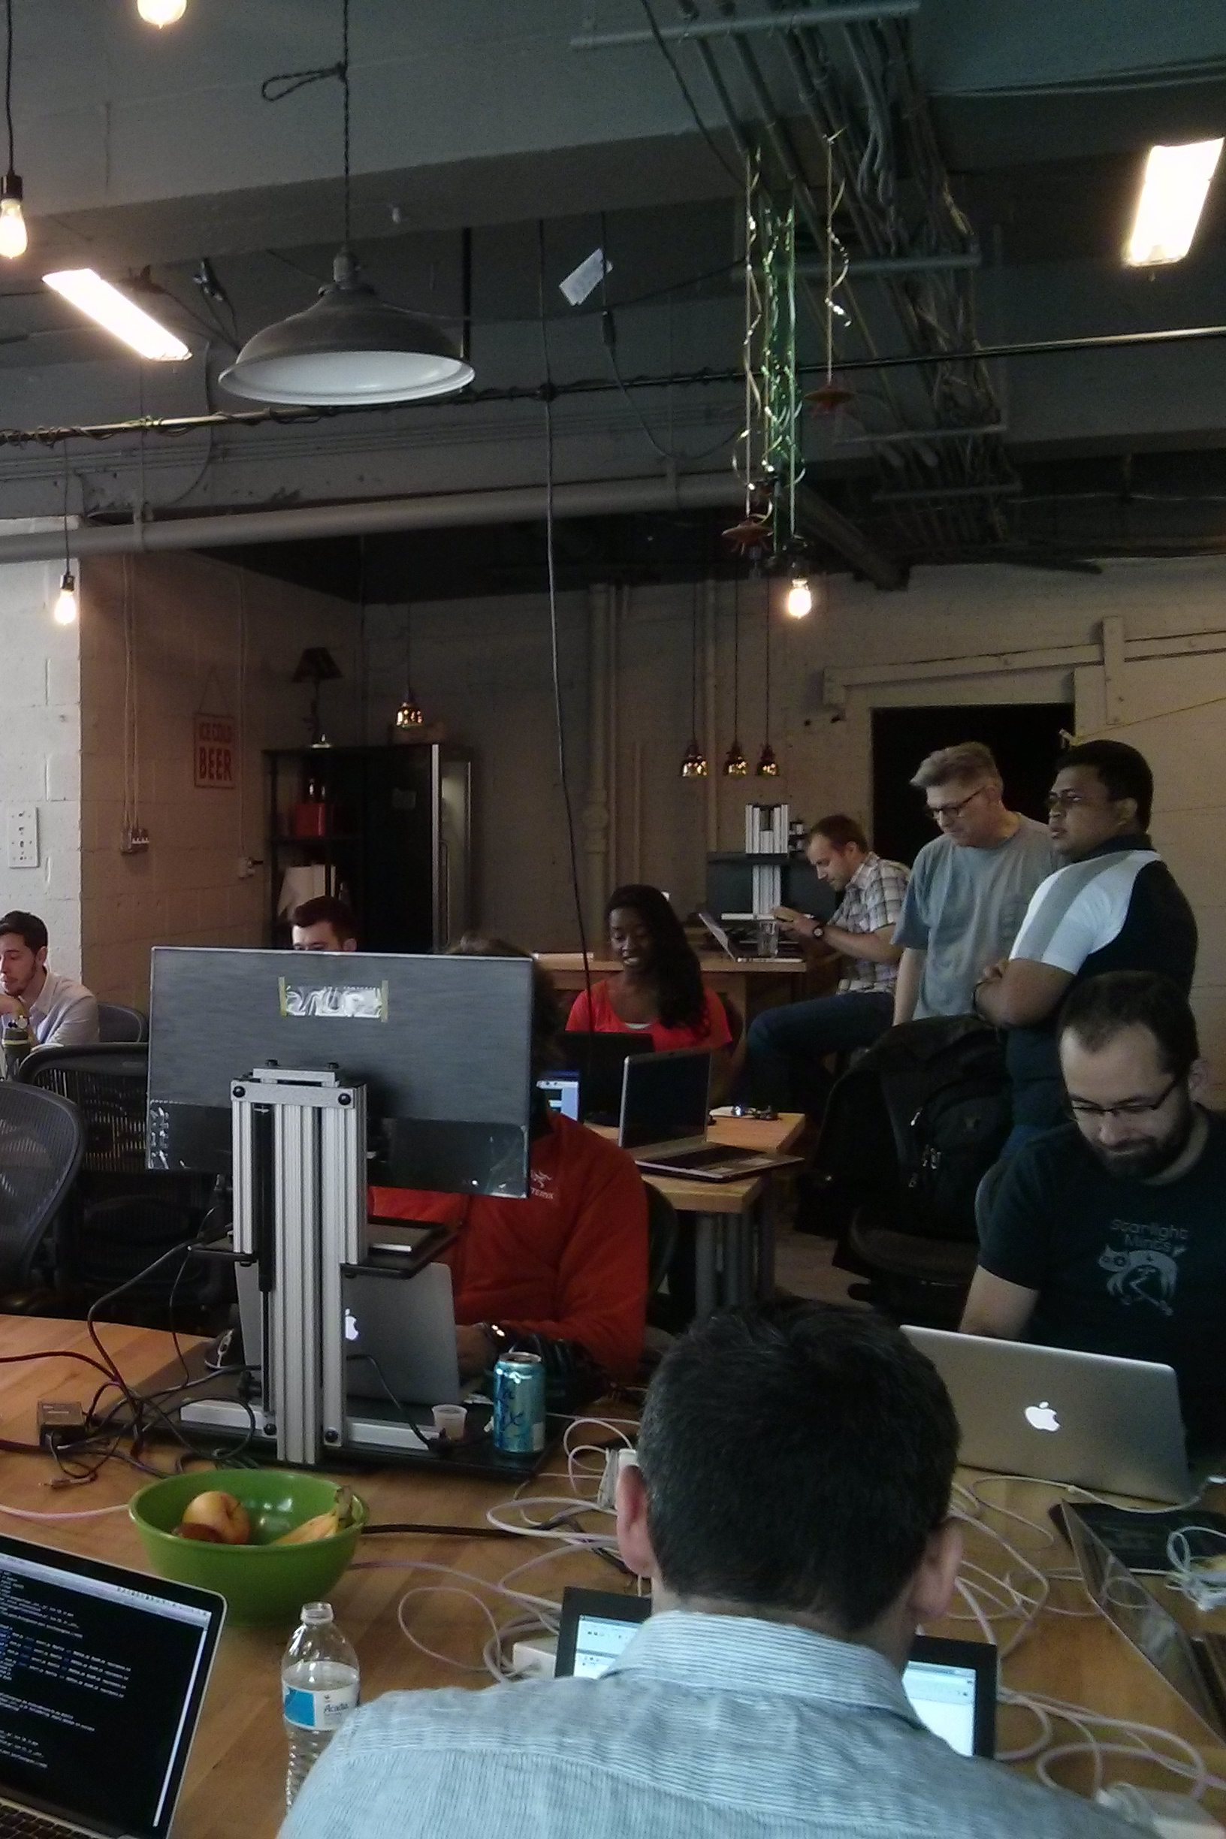
For organizers…
Basic map editing skills
Organizing & managing your mapping event
Using the Tasking Manager, for assigning blocks of work
Quality control, assessment, validation procedures
Ready-made projects for you to adapt to your local conditions
Photo: Mapathon, Spring 2014.
Credit: Brian DeRocher

Slide 17


GeoBadges: Micro-credentials for Mapping Skills
A new initiative to give credentials to mappers and instructors for contributions to OpenStreetMap
Expectations:
Contribute to the map & foster community
Be a Resource for Peers
Develop an Understanding of Basic Digital Mapping Constructs
Contribute to Community Mapping Goals (local, HOT, MapGive, MissingMaps)
Web: http://geobadges.org/

Slide 18
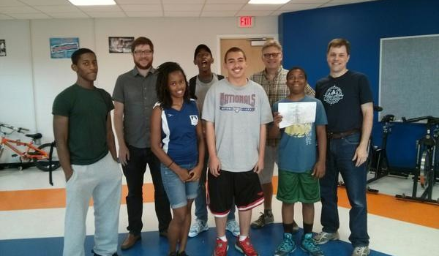
Highlight: TeachOSM and the Georgia Avenue Project
Training Young Adults to Map

Slide 19
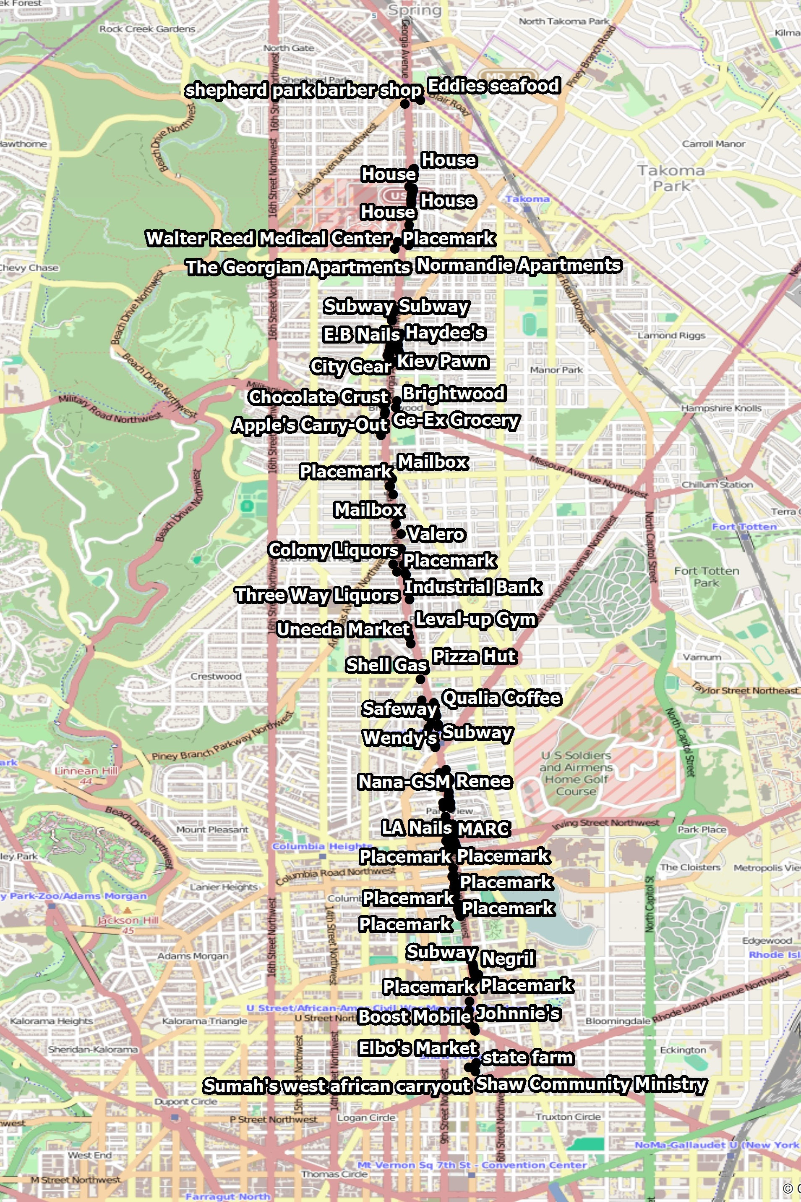
Georgia Avenue Mapping Project
Youth Ambassadors used Georgia Ave data gathered for street-level survey
We trained ~15 Youth Ambassadors in how to edit in OpenStreetMap
Results:
Over 270 features added to the OpenStreetMap
Survey data visible on the map!
http://wiki.openstreetmap.org/wiki/Georgia_Avenue_Youth_Ambassadors_Mapping_Project

Slide 20
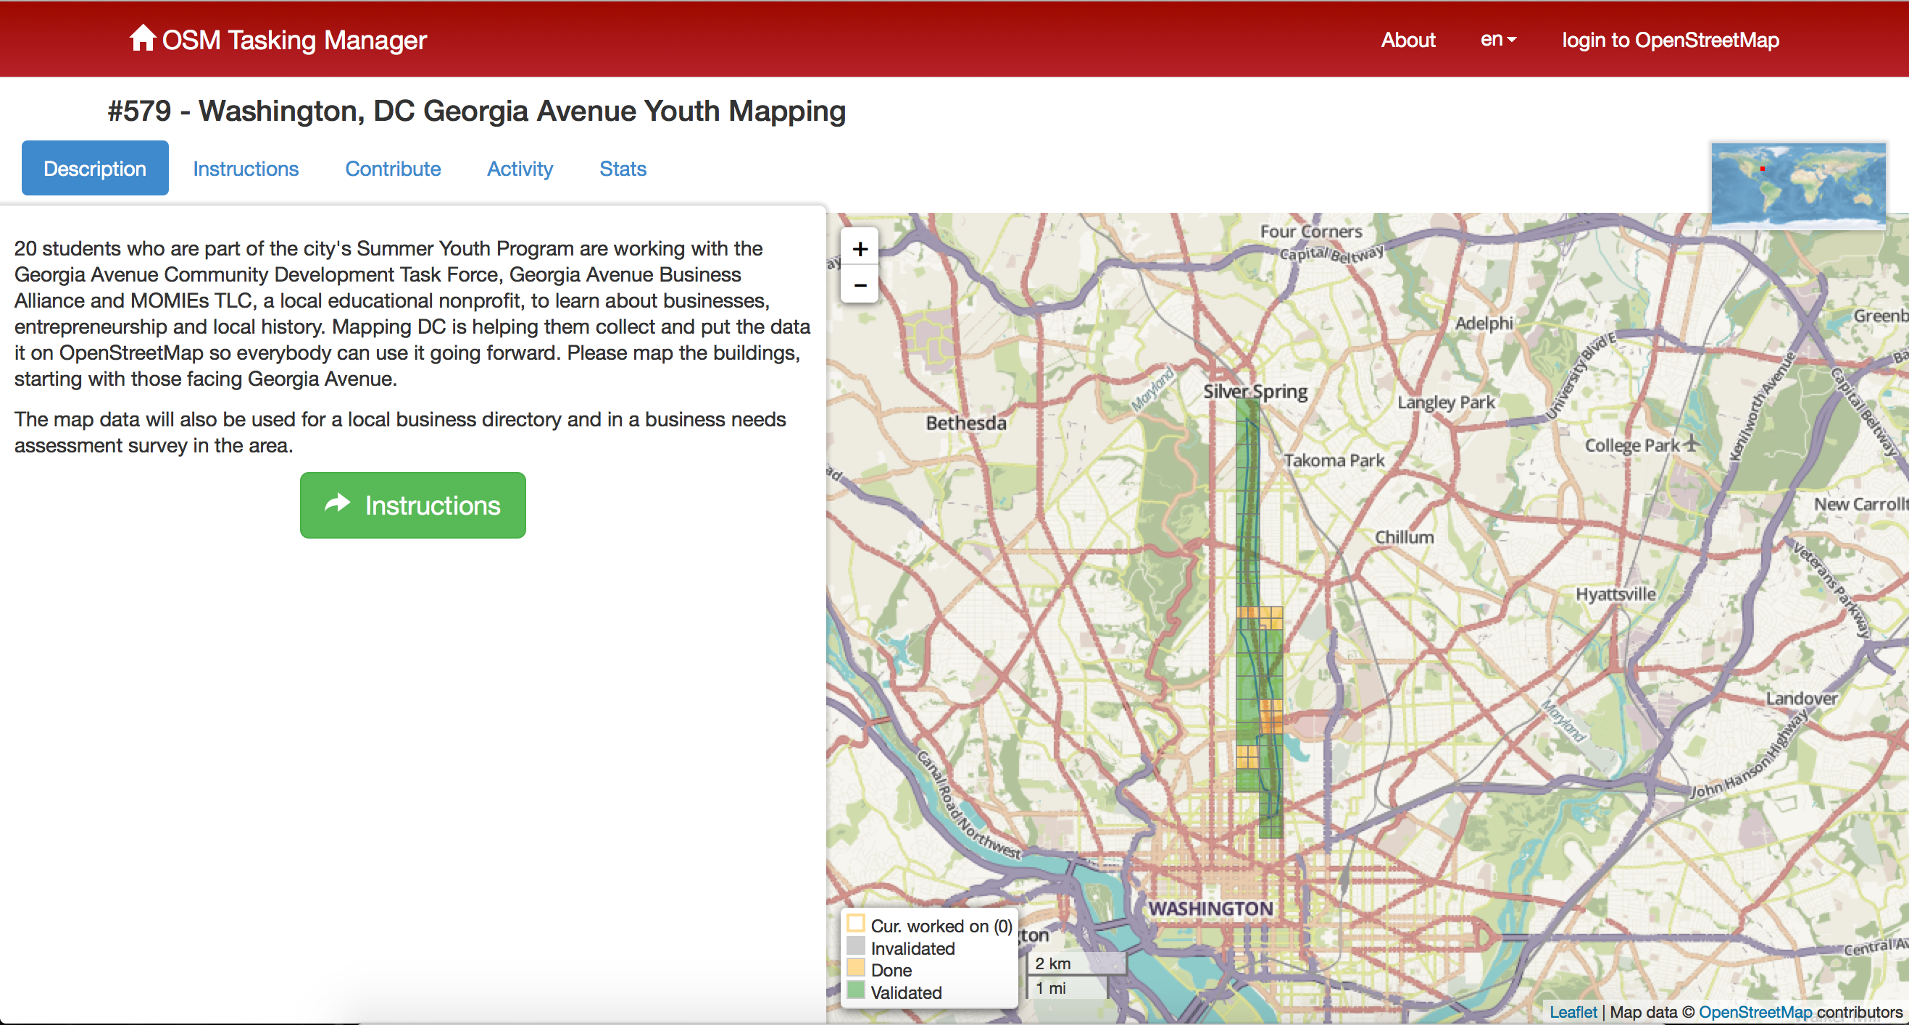
Using the OSM Tasking Manager to control workflow

Slide 21
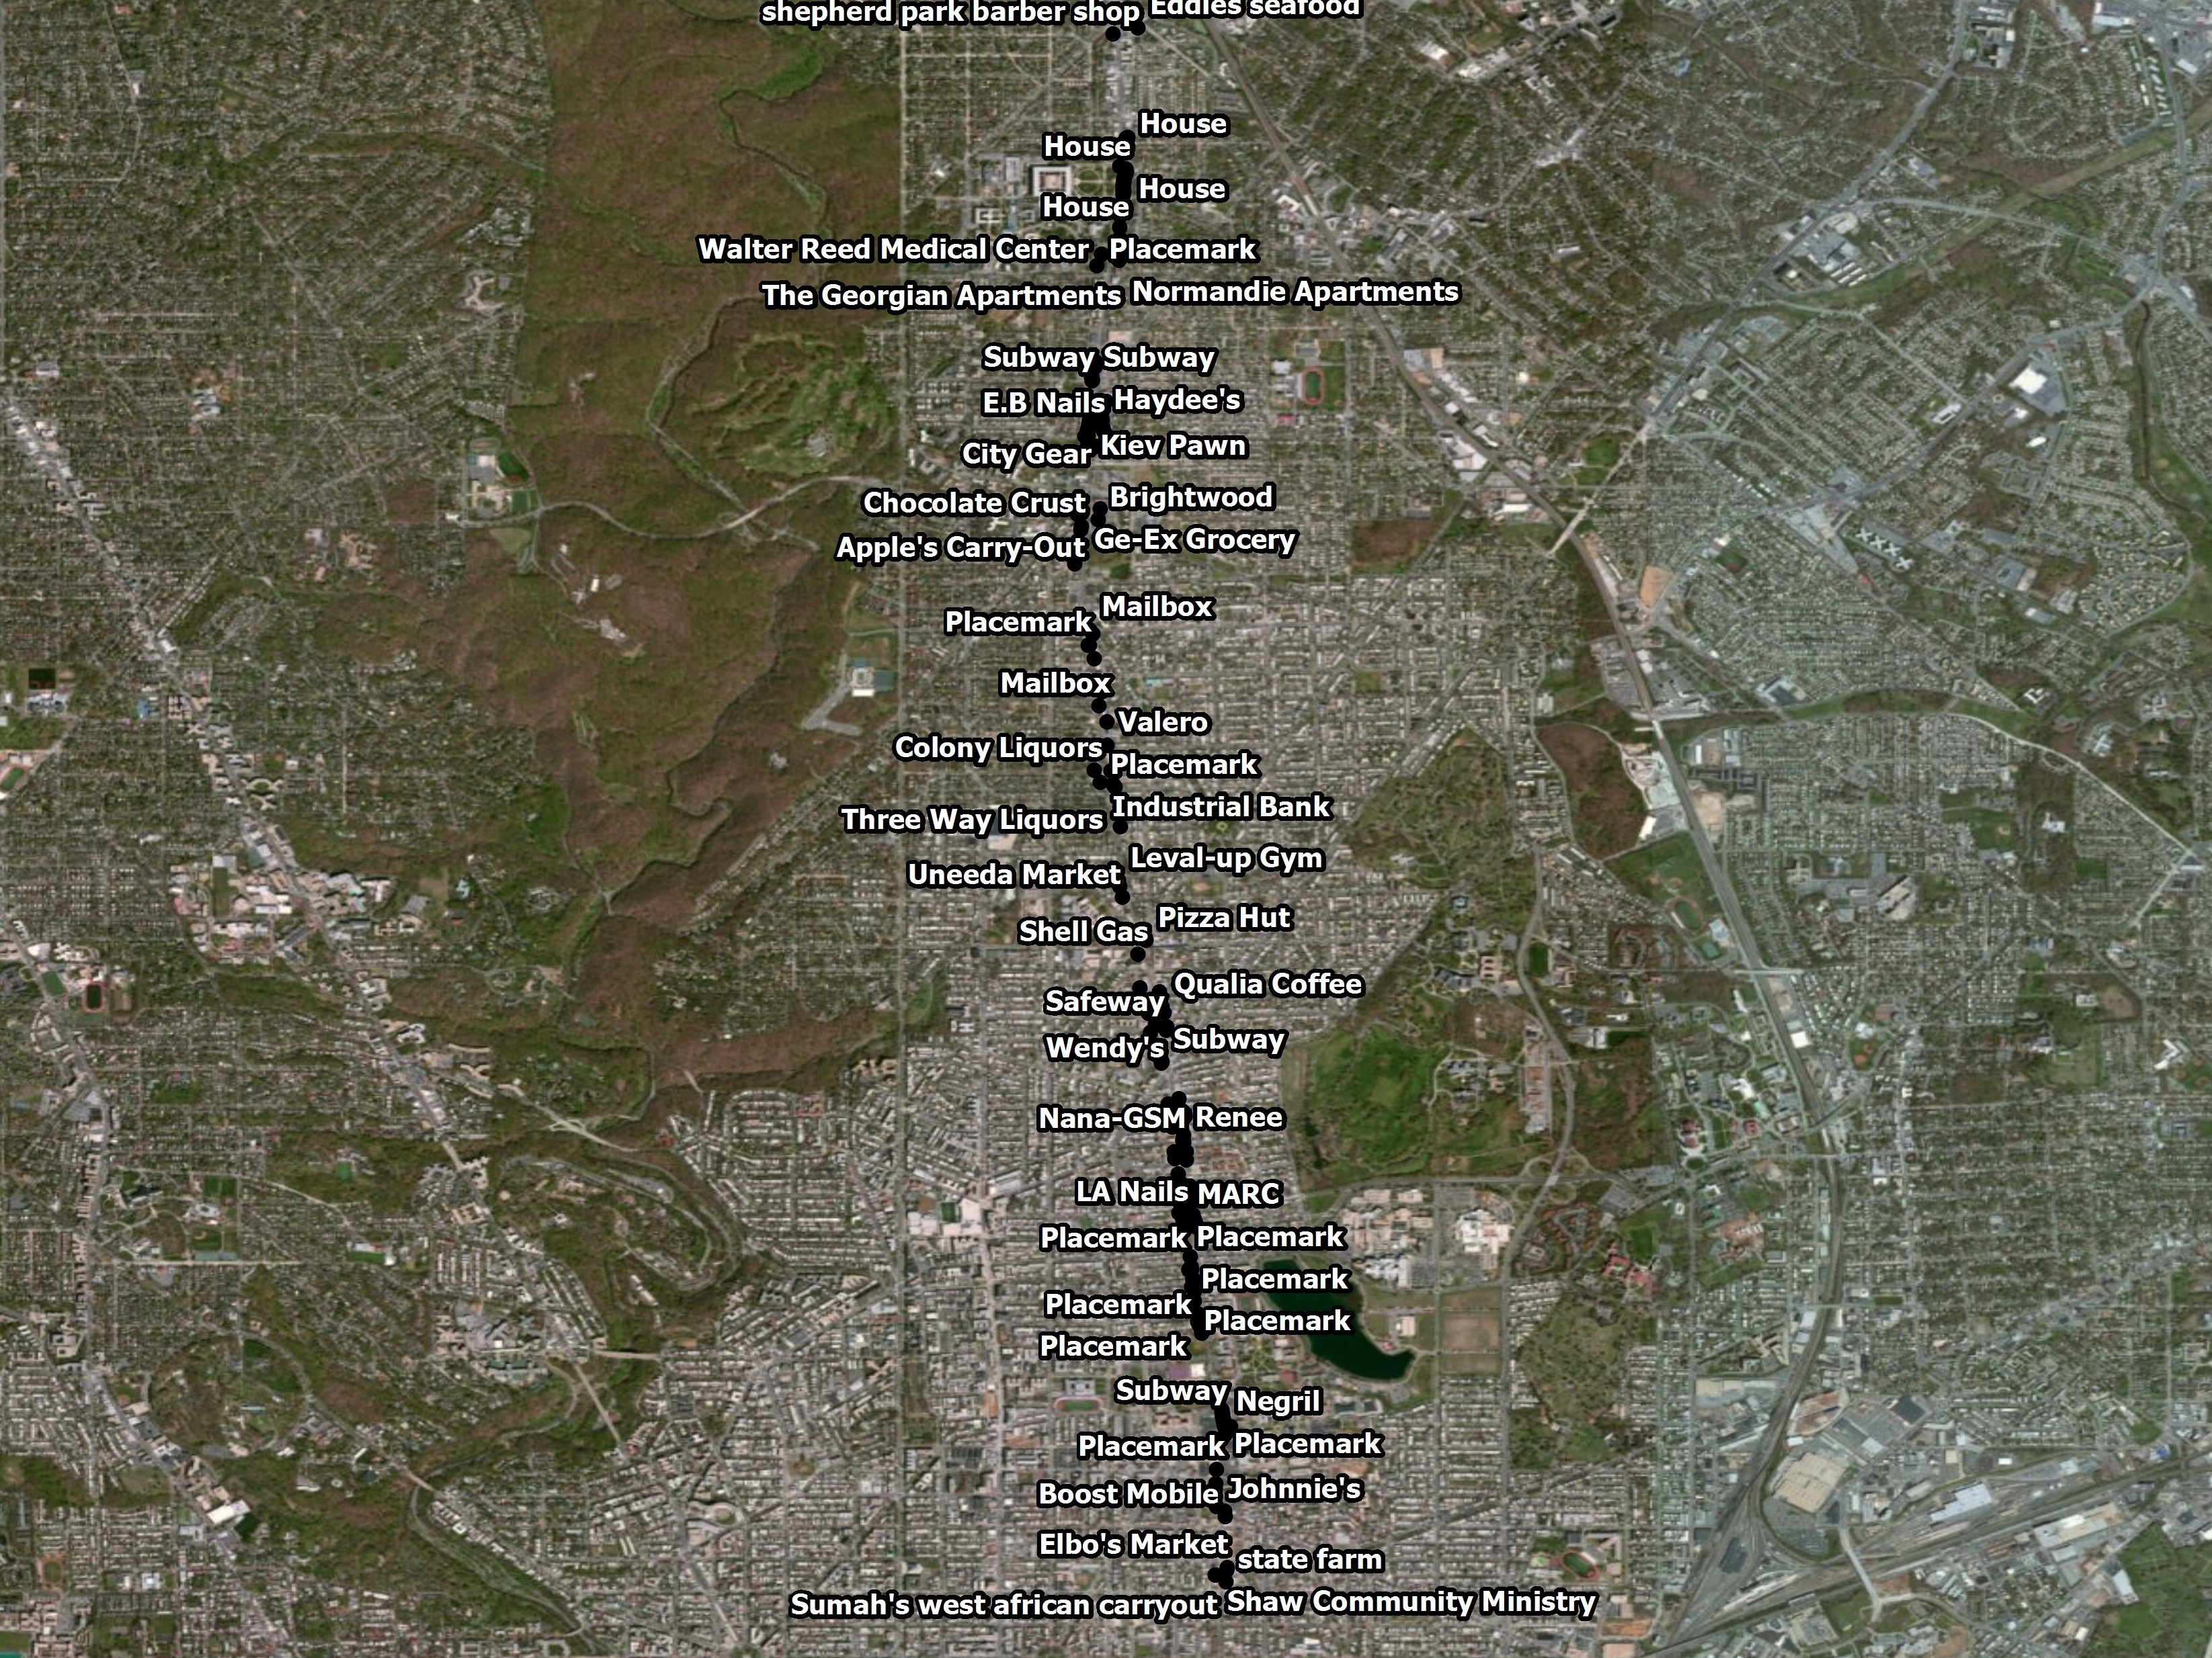

Slide 22
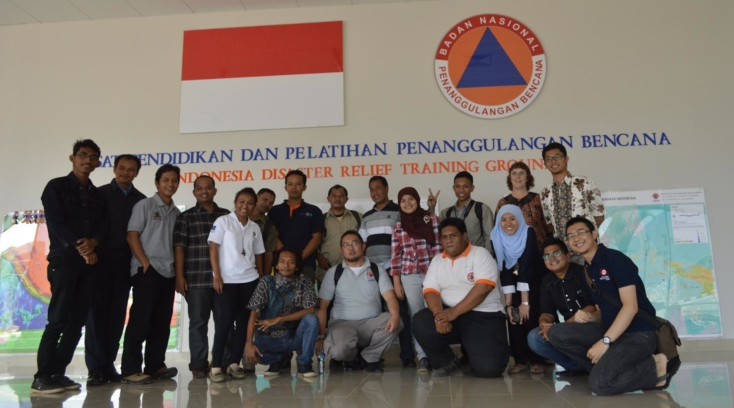
Highlight: HOT Indonesia
University Outreach Program

Slide 23
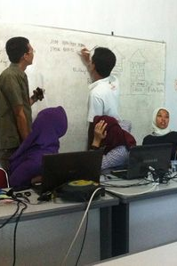
University Outreach & Contingency Planning
Focus is disaster preparedness and contingency planning for vulnerable areas
Working with local communities to identify & map exposure and risk
Using QGIS & InaSAFE plugin for downstream analysis
Over 4 years, conducted 86 trainings, 2300 people trained, ~2m buildings, ~14500 schools

Slide 24
Why TeachOSM?
Six Reasons why OpenStreetMap is an effective tool for community development & social engagement

Slide 25

Highlight: DC Great Streets Survey

Slide 26
OpenStreetMap Gives Participants Immediate Experience
Direct Learning - Active mappers gain direct experience of space, place, and location
Geography at a 1:1 Scale
The terrain is the map
Nurture and understanding of how to read the landscape
Fundamental to Geo-Literacy

Slide 27
OpenStreetMap Reinforces Social & Historical Literacy
Provides meaningful engagement that can broaden academic & career options
History-shaping events often happen at certain places for geographic reasons.
Contributing to OSM, -through site surveys, editing, & meeting other citizens, helps us understand geographic processes that underpin social events.
Helps us plan for the communities we want to live in

Slide 28
OpenStreetMap Supports Collaboration
Mapathons help participants to establish positive relationships with other mappers in the community
Collaborate with your fellow citizens to record features of interest
Share observations about your community
Give visibility to community landmarks

Slide 29
OpenStreetMap Provides Opportunities for to Contribute to the Global Commons
Opportunities to engage in community mapping projects & service learning engagements
Contribute to humanitarian relief efforts through Humanitarian OpenStreetMap Team
Use MapRoulette ‘micro-tasking’ to help improve map quality
OpenStreetMap offers meaningful outlet to maintaining map data in your neighborhood

Slide 30
OpenStreetMap Supports Self-directed [stuff]
The open platform encourages self-guided learning and allows mappers to challenge themselves.
Mapping projects encourage collaboration & teamwork
Students learn how to think critically about geographic features and how to model their world.
Active mapping nurtures people’s natural inquiries into the world.

Slide 31
OpenStreetMap Requires No Special Resources
No software required - works in the browser
No permission required - OSM is a do-acracy: DO IT!
Data are free and can be exported for downstream use in desktop GIS packages (e.g. QGIS, ArcGIS)
Data can be re-combined with other data (e.g. government open data, aerial imagery, etc)
No fees, licensing charges, royalties, paywalls, subscriptions, etc.

Slide 32
Sample Ideas for Projects
Conduct a street survey for economic development :
http://teachosm.org/en/cases/DCGreatStreets_survey_casestudy/
Map for disaster relief/preparedness:
http://mapgive.state.gov and http://missingmaps.org/
Add historical features to OpenHistoricalMap:
http://ow.ly/MfhZw
Map local food resources:
http://teachosm.org/en/cases/farmers-market/
Start a student mapping society:
https://www.facebook.com/GWHMS

Slide 33
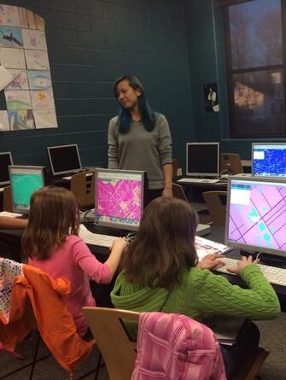
Ready to Map?
Where do I get started?
Subscribe to the TeachOSM mailing list
Send an inquiry to info@teachosm.org
How do I contribute?
Draft a case study for the web site
Organize a mapping project (Yes, we can help!)
Help refine our materials
Photo: middle-school school students learning to map.
Credit: MaptimeLex/Lyzi Diamond

Slide 34
Summary
As an open freely editable map of the world, OpenStreetMap is an excellent platform for teaching geography and for community engagement
OpenStreetMap offers students geo-literacy, social ties, service learning, and independent learning opportunities.
OpenStreetMap is free and requires no special equipment
Use TeachOSM and help us make it better

Slide 35
Resources for OpenStreetMap-based projects
TeachOSM - http://teachosm.org/
LearnOSM - http://learnosm.org/
MapGive - http://mapgive.state.gov
MissingMaps - http://www.missingmaps.org/
Humanitarian OpenStreetMap Team (HOT) - http://hot.openstreetmap.org/
QGIS - http://qgis.org/
GeoBadges - http://geobadges.org/
Real-time contributions to OSM in Nepal: http://osm.townsendjennings.com/nepal/
OSM wiki page on Nepal earthquake: https://wiki.openstreetmap.org/wiki/2015_Nepal_earthquake

Slide 36



Thank You!
Steven Johnson, Principal
Geomantic Labs
sejohnson8@gmail.com
@geomantic
geomantic
Contents of this document are licensed under Creative Commons Attribution & Share-alike license: https://creativecommons.org/licenses/by-sa/4.0/
Maggie Cawley, CEO
Boomerang Geospatial
maggie@boomgeo.com
@maggiemaps
mcawley

